Slide 1

Exploring the Role of AI in Engineering
Session Organizers:
Nader Jalili, Southern Methodist University, Session Lead
Aaron Bobick, Washington University in St. Louis
Amit Shukla, Seattle University
Session 1: AI in Higher Education: Navigating Impact and Future Trends (9:15 – 10:30 am)
  How AI is going to revolutionize education through personalized learning pathways and intelligent tutoring systems?
  Ways AI enhances administrative processes.
Session 2: Navigating the AI Landscape: Bridging Academic Research and Industry Expectations (11:00 – 12:15 pm)
  The dynamic interplay between academic research in AI and the evolving expectations of the industry.

Slide 2
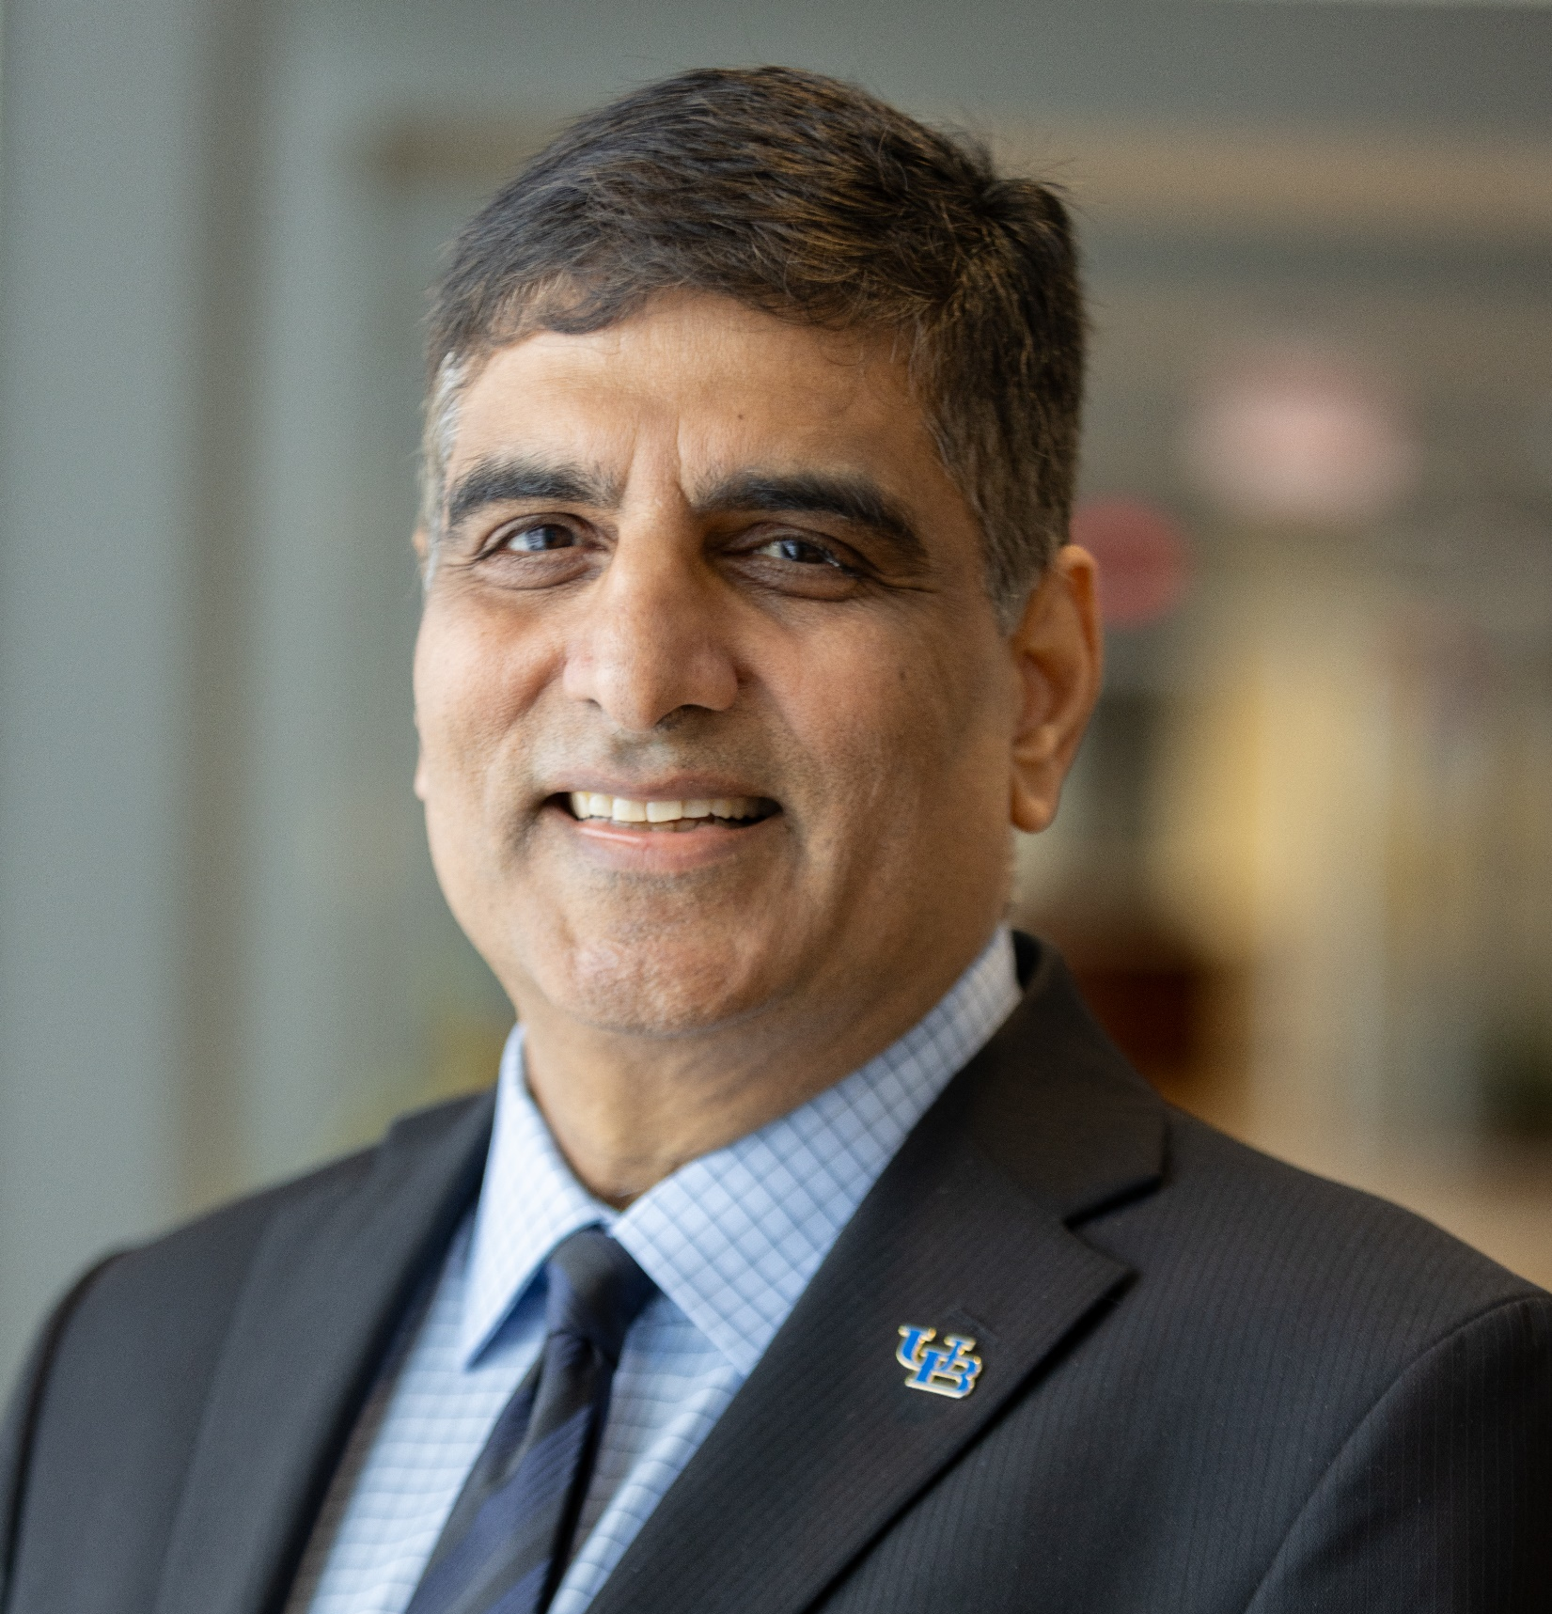
AI in Higher Education: Navigating Impact and Future Trends
Dr. Venu Govindaraju
Vice President for Research and Economic Development
SUNY Distinguished Professor of Computer Science and Engineering at UB
Dr. Govindaraju established the Institute for Artificial Intelligence (AI) and Data Science, National AI Institute for Exceptional Education and is founding director of the Center for Unified Biometrics and Sensors.
He has led sponsored projects totaling more than $95M, holds six patents and refereed close to 500 scientific papers.
An authority on AI, Govindaraju’s work in handwriting recognition is at the core of the first handwritten address interpretation system used by the U.S. Postal Service.

Slide 3

AI in Higher Education: Navigating Impact and Future Trends
Prof. Ian Lane
Associate Professor of Computer Science and Engineering
Director of the Natural Language Processing Master’s Program
Associate Dean for Silicon Valley Engagement, UC at Santa Cruz
Dr. Lane's research focuses on techniques, models and frameworks that allow conversational language technologies to be effective in-the-wild and across language barriers. His work has focused on multilingual speech recognition, machine-translation and conversational AI.
He is now concentrating his efforts on harnessing these technologies to empower education, amplifying the effectiveness of educators while supporting and guiding students to improved educational outcomes

Slide 4

AI in Higher Education: Navigating Impact and Future Trends
Prof. E Bruce Pitman
Interim Vice-President & Chief Information Officer
Professor of Materials Design and Innovation, Univ. at Buffalo
A mathematician by training, Prof. Pitman's research has centered on mathematical modeling and computing, uncertainty quantification, and predictions for disciplinary applications, with interests ranging from the functioning of the kidney to the hazard risk from volcanological flows.
Prof. Pitman is a former Vice-Provost and former Dean of UB’s College of Arts and Sciences.
He was Director of UB’s Institute for Computational and Data Sciences and Engineering. He currently serves as the Interim Vice-President and Chief Information Officer.

Slide 5
AI IN EDUCATION
Venu Govindaraju

Slide 6
HISTORY of AI
1950
TURING
Imitation game and Turing test
1957
Simon & Newell
First Theorem Proving program
1972
Stanford Univ
MYCIN Expert Systems
1986
Rumelhart
ANN with learning by back propagation
1997
IBM DEEP BLUE
Beats world chess champion
2004
DARPA
Autonomous vehicle program
2007
Fei Fei Li
“Big Data”
& ImageNet
2009
Andrew Ng
Large scale unsupervised learning with GPUs
2022
ChatGPT
New language processing AI from OpenAI
1950
1955 - 57
1972
1984 - 88
1997
2004 - 07
2009, ‘11, ‘22 & beyond
1955
McCarthy
Coins the term
“Artificial Intelligence”
1957 Rosenblatt
First two-layer ANN called Perceptron
1984
Schank
& Minsky
“Winter of AI”
1988
Pearl
Bayesian Networks reasoning with uncertainty
1997
UB EARLY SUCCESS
- POSTAL
Govindaraju et al
2006
Hinton
“Deep Networks” “Deep Learning”
2011
IBM WATSON
Wins Jeopardy
2014
GANs
2017
Transformers

Slide 7
+20
AI systems perform BETTER than humans
SUPER
AI
Smarter
than Humans
0
Human performance (benchmark) set to 0
AI systems perform WORSE
GENERAL AI
Operating
at a
Human level
NARROW AI
Specialized
in One Task
-20
-40
Handwriting Recognition
-60
Reading
Compre-
hension
AI vs HUMAN
Performance
Speech Recognition
-80
Image
Recognition
Language Understanding
-100
2000
2005
2010
2015
2020
The capability of each AI system is normalized to an initial performance of -100.
SOURCE: Kiela et al. (2021) Dynabench: Rethinking Benchmarking in NLP OurWorldData.org/artificial-intelligence

Slide 8
Generalizations
Nuances
World Knowledge
Sentiment
Robustness Large # classes Interpretability
Text fusion
Accents Dialects
Low resource Noisy env
Multiple speakers
Disfluency Privacy
Adaptation
Cursive Datasets
Multilingual
Smudges Overwrites
Contexts
Occlusion
Annotated data
Temporal
Simultaneous Activity
Wearable sensors
UNSOLVED
Image Recognition
ImageNet
Face Recognition
Radiology
License plates, Vehicle type
Retail Fashion
OCR
Speech Recognition
Conversational transcript
Voice Assistant SIRI, ALEXA
Forms
Dictation DRAGON
Video Understanding
Sports Analytics
Surveillance Anomaly Detection
Object Tracking
Lip Reading
Gesture Recognition
Handwriting Recognition
Postal
Cheque
Forms
Transcription Mapping
Language Understanding
Q&A
Multiple Choice Qs
Forms

Slide 9
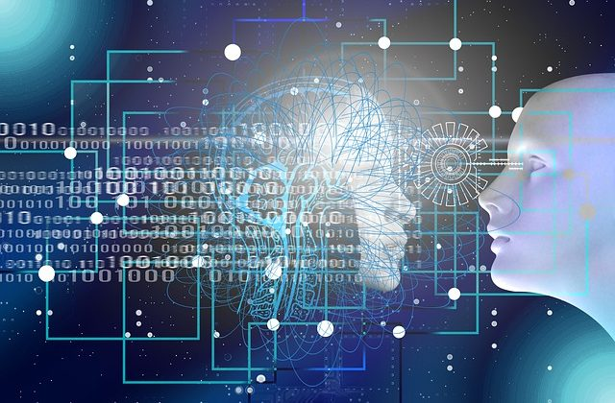

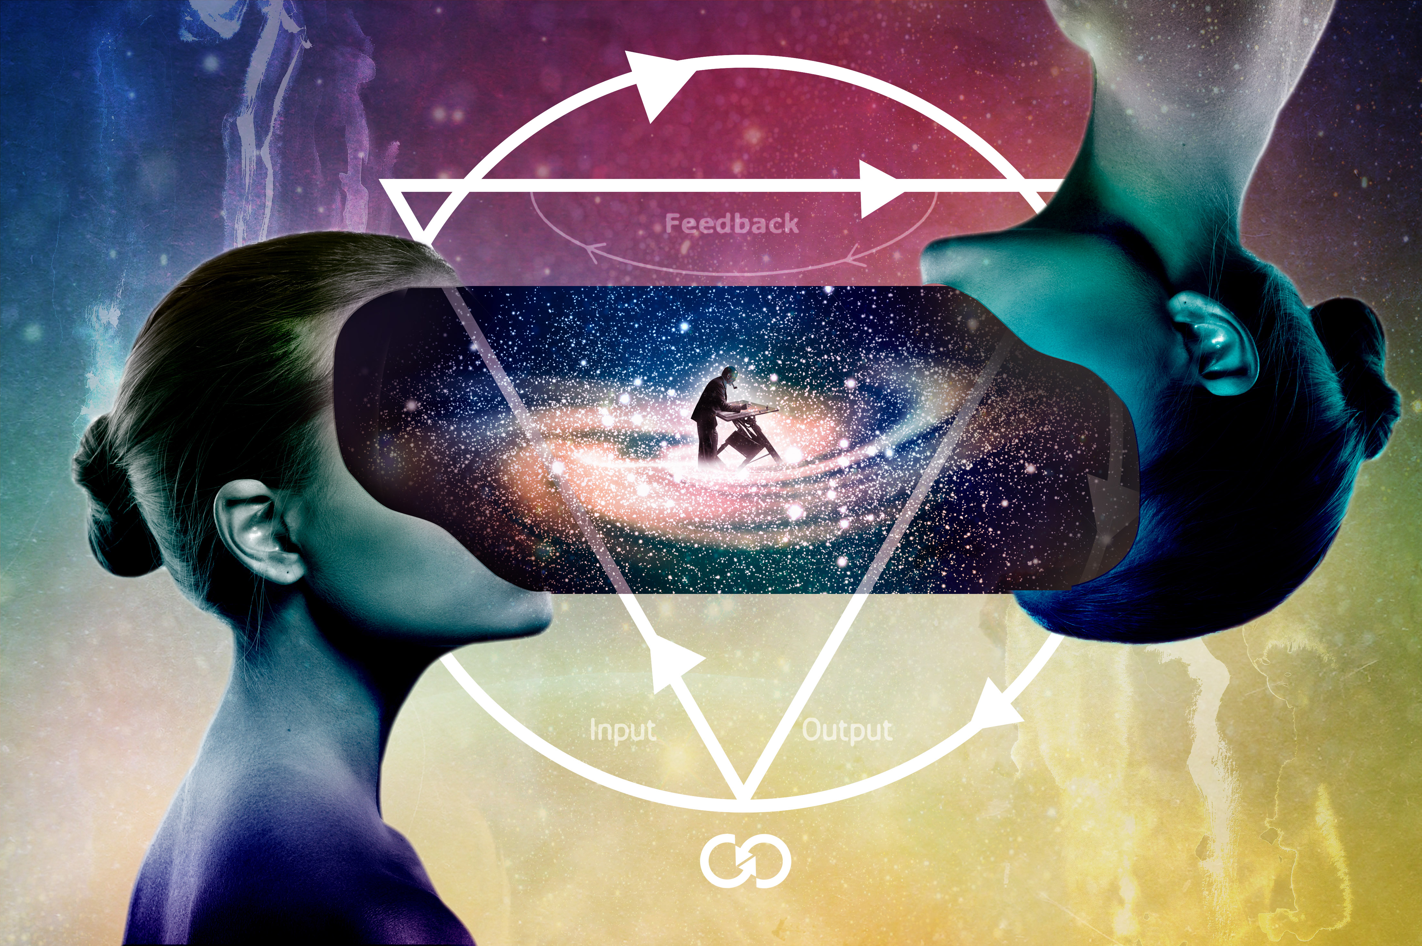
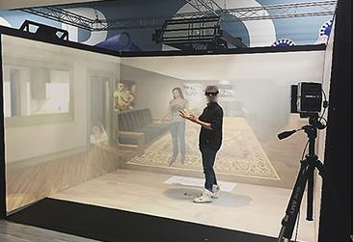
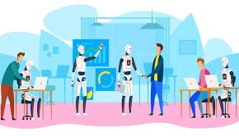


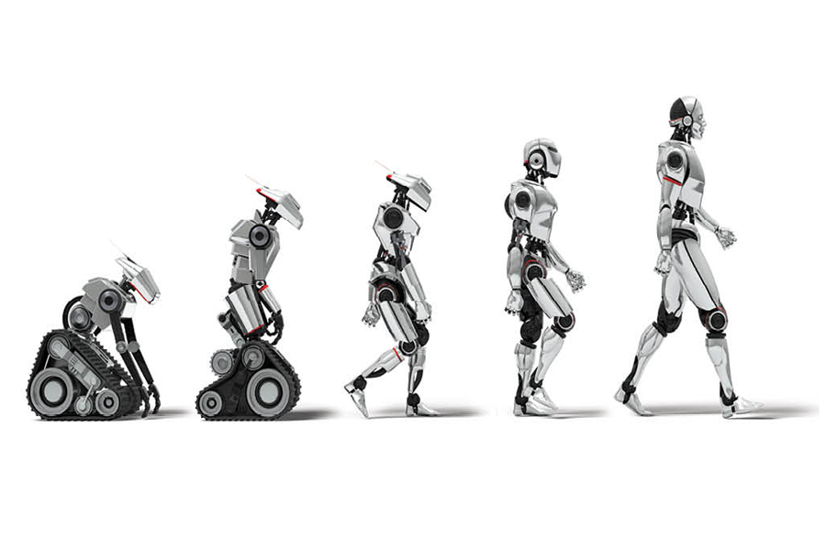
Language Understanding
Communication
& Collaboration
Video Understanding
Immersive Environments
AI Technology in Education
Content Generation
Virtual Assistants
Analytics
Robotics

Slide 10






Administration
Learning Environments
Workforce Development
Admissions, registrations, records
Enrollment patterns
Resource allocation, strategy
Adaptive to learning difficulty, performance
One-one-tutoring, early warnings of risk
Simulation based learning, VR chatbots
Skill gaps, ability to pivot quickly
Career trajectory tracking
Continuing education options
EDUCATION MATRIX
Engagement, public good
Democracy, communication
Social justice, diversity, inclusion
Faculty consulting, sabbaticals
Internships, career experience
Curriculum partnerships
Commercialization, tech transfer
Job creation, talent pipelines
Investment funds, startups
Community Engagement
Industry Collaboration
Economic Development

Slide 11
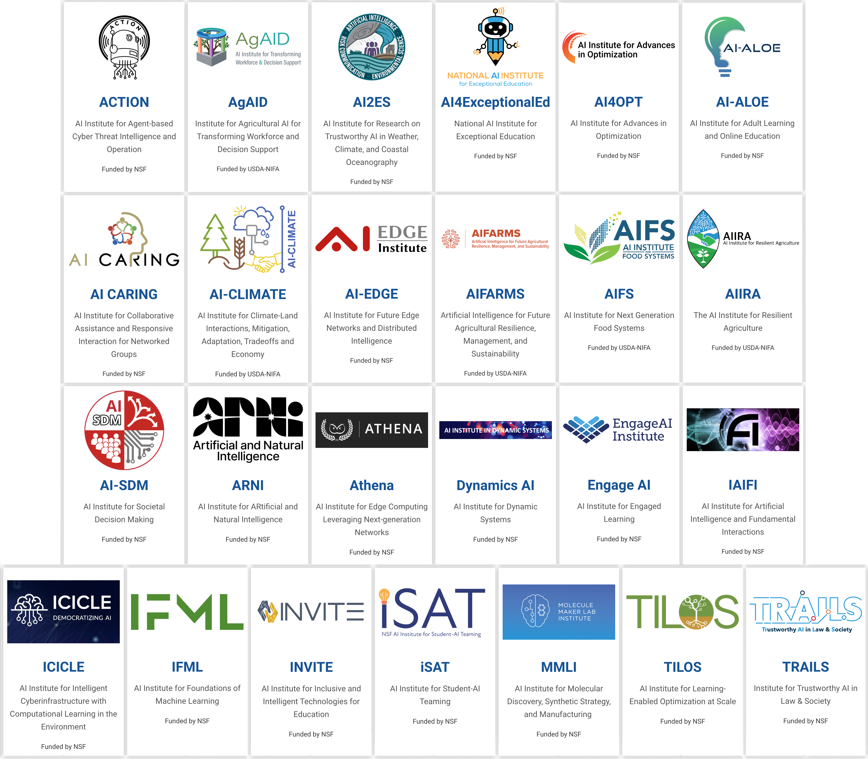
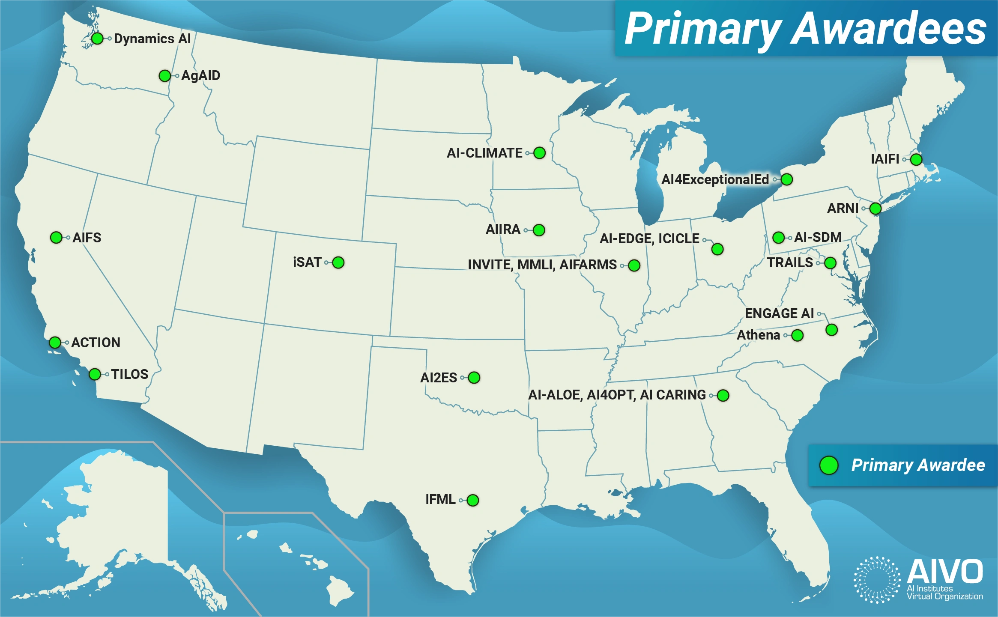
AI INSTITUTES
EDUCATION AGRICULTURE (USDA)

Slide 12




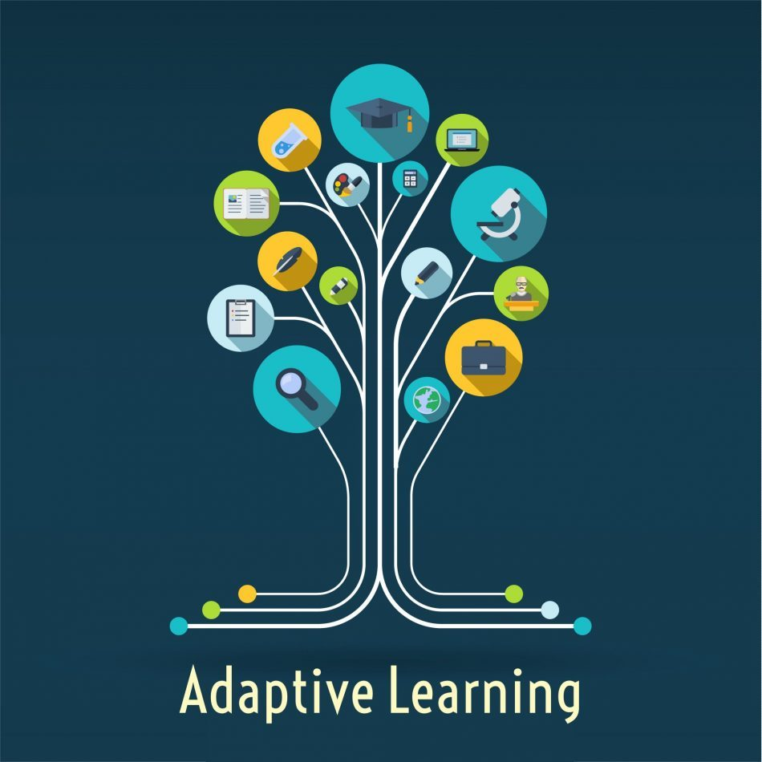



Adult /Lifelong Remote Collaborative Personalized
GaTech Colorado
NC State UIUC UB
Adaptive Narrative Equitable EXCEPTIONAL
AI in LEARNING

Slide 13

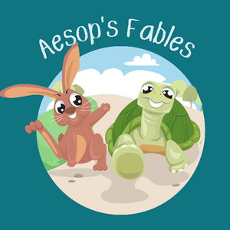

Narrative Learning
CHARACTERS empathy
MORAL & ETHICAL
EFFECTIVE assessment
STORY TELLING energizing, humanizing
CONTEXTUAL cultural
PLOT compelling, engaging
Portland
Boston
Traveling Salesperson Problem
Find shortest route between set of points and locations.
Given a list of cities and the distances between pairs of cities, find the shortest route a salesman must take that visits each city exactly once and then returns to city she started.
Detroit
Denver
Dallas
Miami
Aesop’s Fables
The tortoise
and the hare
The boy who cried wolf
Interactive
Books, etc.
Active learning

Slide 14
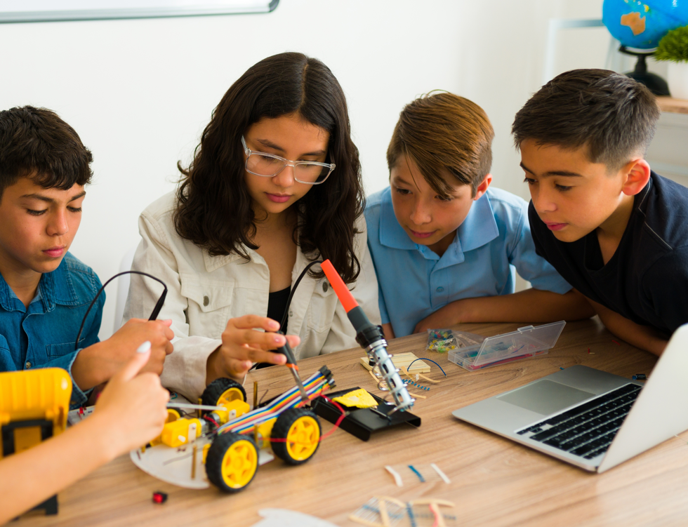

Learning Paradigms
COLLABORATIVE LEARNING
Problem solving
Diverse skills
Shared goals
Interdependence
ADULT LEARNING
Intrinsic motivation
Prior learning
Flexible schedule
Personalized path
Interactions
Social skills
Conflict resolution
Individual accountability
Virtual assistants
Adaptive levels
Job market alignment
Immediate feedback

Slide 15

Pathologists Personalized attention Interventions Equipped classrooms
Inclusive Cultural cognizance Equity of opportunities Fulfilled potential
Equitable and Inclusive Learning

Slide 16















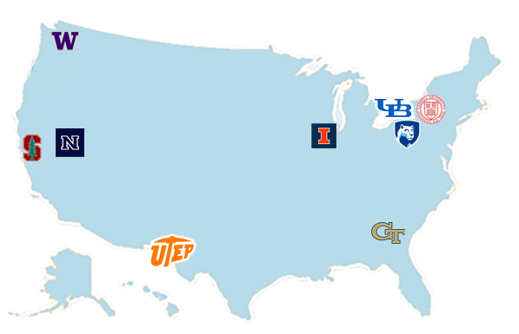
















NSF AI INSTITUTE
Exceptional Education
University of Washington
University at Buffalo
University of Nevada, Reno
Cornell
Exceptional Education
Penn State
University
Stanford University
Georgia Tech
University of Illinois
Urbana-Champaign
The University of Texas at El Paso
31 Researchers | 9 Institutions

Slide 17



HOW AI CAN HELP?
AI
Interventions
Generative AI Tools
Storytelling
Avatars Robots
Checklists, Tests
Observations
Disability Identification
S&L METRICS
Writing | Speech | Non-verbal
Tidiness, legibility | Vocabulary | Micro expressions
Spellings, grammar | FSV, PGU | Gaze, eye contact, pupil dialation
Punctuation | Automaticity, Prosody, fluidity | Emotional states: boredom, confusion
Gestures | Construction | Body language
This Photo by Unknown Author is licensed under CC BY-SA

Slide 18
POWERFUL
PARADIGM SHIFT
The Institute aims to advance AI to scale Speech & Language Pathologists (SLPs) so that no child in need of services is left behind. Our technologies both complement and supplement human expertise.
Providing SLPs with time-saving tools novel, multifaceted insights to serve our children and elevate their academic potential.
The US alone has
3.4 million children in need of Speech and Language services.
There is a significant shortage of Speech
and Language Pathologists (SLPs).
Notes:
The Institute aims to advance AI to scale SLPs so that no child in need of speech and language services is left behind. This represents a powerful paradigm shift. It provides SLPs with time-saving tools and novel, multifaceted insights to serve our children and elevate their academic potential. Our technologies both complement and supplement human expertise.

Slide 19


» Document Intelligence
» Education
» Environment
» Biometrics
Artificial Intelligence
» Information Integrity
» Cybersecurity
» Robotics
ENABLING RESEARCH INNOVATIONS
» Transportation
» Materials

Slide 20

THANK YOU!
लोकाः समस्ताः सुखिनो भवन्तु |

Slide 21
AI in Higher Education: Navigating Impact and Future Trends
Prof. Ian Lane
What is Happening Today?
  AI as a central component of research in pedagogical studies and student success
  Empowering educators and students with AI-enhanced educational platforms
What is Coming?
  Personalized learning across long-term educational journeys
  Opportunities of AI for new frontiers in education
How Can We Prepare?
  Own our own future by leading to provide more equitable, inclusive, and accessible education

Slide 22
To begin
42

Slide 23
AI in Higher Ed
Distinguish ML and GAI
  ML is the ”old” AI.
    Mathematical & statistical models
    Trained, validated
  GAI is the current rage
    LLMs and tokenized prediction
    Trained on ??

Slide 24
ML successes and failings
Image identification and adversarial attacks. Panda bears the ML model is 99% sure is a monkey
Tesla autopilot ramming into a parked white panel truck
HR tools and biases
Reading medical images
Predicting the structures of proteins
  In both cases, human in the loop.
Recall: Bank failures of 2008

Slide 25
GAI successes and failings
Summarize long reports
Write code chunks
Hallucinations
Ethical issues abound. e.g. communications group at UB
The Atlantic last week: asking whether GAI has become passe – no longer the hottest thing, but a tech tool.

Slide 26
Survey at UB
Some faculty using significant GAI tools in classroom, some adamantly opposed.
Most want to learn more, are interested in potential use.
Most faculty recognize that student need to be prepared for the working world.
Appropriate use of AI for students at different stages of their careers – freshmen need to learn how to write without ChatGPT, seniors need to be comfortable with AI tools, graduate students need to master AI.
But also know how to prompt a transformer well, to summarize a report or to write some code snippets.
Many articles, academic and technology media, with titles like “Scientists Trust AI Too Much”

Slide 27
What is Coming at Us?
Critical need to train faculty, staff on the business side of the house, faculty and students on the instructional side, on the ethical issues of GAI and on data security issues.
Significant concern coming at us regarding HIPAA and CMMC data security for all our researchers. How do we facilitate research “under a HIPAA bubble”?
  And all the graduate research assistants who administer compute clusters for us!!
Business side of the house…will campuses need to provision and train their own LLM with data that can be kept entirely on campus…Remove some of the security concerns?

Slide 28
To begin, again
42. Deep Thought
The purpose of computation is insight, not numbers. R. Hamming
Let's make sure that, with all the potential of AI, whatever flavor, the notions of incomplete mathematical/physical/computational models, of uncertainty in inputs and consequently in outputs, are conveyed to our students, that we instill in our students a humility about our calculations and the need for ethical, explainable computations and responsible supervision of the predictions we are being asked to make.

Slide 29
Interactive Discussions and Q/A (Pls. complete the survey)
  How AI is going to revolutionize education through personalized learning pathways and intelligent tutoring systems
  Ways AI enhances administrative processes
  The dynamic interplay between academic research in AI and the evolving expectations of the industry.
  What is Happening Today? What is Coming? And How Can We Prepare?

Slide 30
Thank you all for your time and thoughtful inputs!
Session 2: (11:00 – 12:15 pm)
Navigating the AI Landscape: Bridging Academic Research and Industry Expectations

